Slide 1
Extending a Component-Based Architecture
1st Year PhD Report, 16th June 2006
Andrew McVeigh
Supervisors: Jeff Magee and Jeff Kramer

Slide 2
Introduction & Problem Context

Slide 3
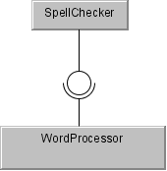
Extending a software product by adding components...
Many products have architectures that allow new functionality to be added via new components
  Motivation is to allow 3rd party developers to extend
  E.g. Firefox, Eclipse, MindManager, MagicDraw, PoseidonUML, Excel…
New Component
Base product

Slide 4
Some Terminology
The original product is called the “base”
A coherent set of added components, with customisation instructions, are an “extension”
Base and extension developers are usually disjoint
Base and extension are relative concepts
  An extended system could be the base for another extension

Slide 5
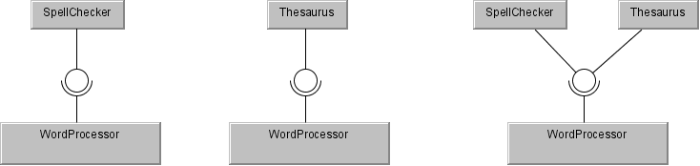
Issue 1: Combining Independent Extensions
The architectural approach encourages independent development of extensions
  It is natural to want to combine these into a new system
  The extensions often conflict and interfere with each other
#1
#2
#1 + #2

Slide 6
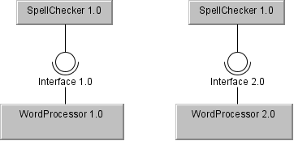
Issue 2: Old Extensions
When the base evolves, the old extensions often misbehave or cannot be used
    E.g. Firefox upgrade disables old extensions
The “old extensions problem” is currently found through testing

Slide 7
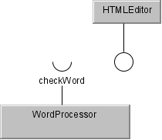
Issue 3: Unplanned Extension
The base makes assumptions about what extensions will want to do
  Extensions that need more must wait for new versions of the base
  These are issues even for software delivered internally in an organisation

Slide 8
Background

Slide 9
Extending and Evolving Component-Based Systems (1)
Plugin architectures
  E.g. Eclipse/OSGI [26], MagicBeans [10]
  A plugin is a component
  Related to the framework concept [36]
  Rely on a balance between the independent extensions and unplanned extensions problems
Version control for component architectures
  Controlling versions of components and connectors to manage architectural evolution [61]
  May require a deep understanding down to the source level

Slide 10
Extending and Evolving Component-Based Systems (2)
Mixins are “abstract subclasses” [9]
  Multiple mixins can be combined in one class
  Scala [63] uses mixins to address combining extensions
  Also addresses the “independent expression problem”
  Mixins suffer from naming clashes, and in Scala conflicts must be manually resolved
Product-Line Architectures
  Aim is to produce a set of components supporting a family of applications
  Evolution of single components is a problem [56]

Slide 11
ADLs
ADLs describe the architecture (structure, behaviour) of a system separately from its implementation
  Component indicate provided and require interfaces
  Composite and leaf components
  Components are wired together with connectors
  Reconfiguration primitives allows architectural evolution [32]
  Relevant ADLs are Darwin [33], C2 family [58] and
  UML2.0 [20, 49]

Slide 12
Feature Composition
Telecoms systems must deal with addition of functionality without affecting existing services
  Feature interaction is a common issue
  Feature composition [22] uses relational assertions to model the state and effect of features on the global state
  Invariants are used to model inviolable aspects of a feature
  Interaction is detected by observing runtime effects on invariants

Slide 13
Techniques and Results

Slide 14
Requirements
Engineering focussed approach
  UML for familiarity
  Applicable to large systems
  Tool support for design & guided resolution of problems
Static analysis
Focus on design time, not run-time
Approach applicable even without implementation source code

Slide 15
Approach
Use an ADL (Backbone) to model the structure and behaviour of the system
  Composite components allow fine-grained decomposition
  Extensions can contain new components, and reconfigurations of old components to prepare the base
  Component protocols are described using UML sequence diagrams
  Goal-level properties of an extension must be preserved

Slide 16
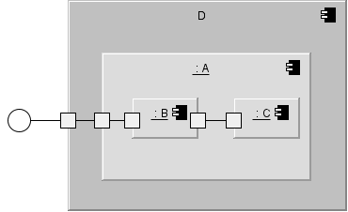
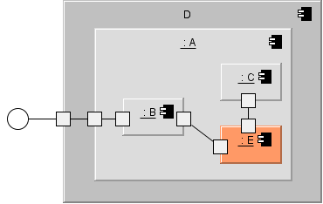
How does this help?
Base is expressed as fine-grained components
  Extension can reconfigure or change at any level
  Reduces likelihood of conflict via independent extensions or old extensions problem
Base
Extension
(deltas)
Result
+
Reconfig.
+ new component E
=

Slide 17
Primitives to Model Any Change
Primitives allow for unplanned changes
  Upversion models code level changes in interface or component implementation
  Supplant models change in Backbone changes only
Aim is to model extending and evolving the system uniformly via extensions
  Reduces the independent extensions and old extensions problem to the same issue:
  The ability to combine extensions

Slide 18
Steps in Combining Extensions
1. Extensions may conflict structurally
  Flattening out the component graph of each extension shows conflicts
  The need to share services is a common theme…
2. Extensions may interfere behaviourally
  Interference at a single component level
  Use protocols to express component expectations
3. Extensions may interfere with each others goals
  Much work to come to express properties of the extensions that must be preserved

Slide 19
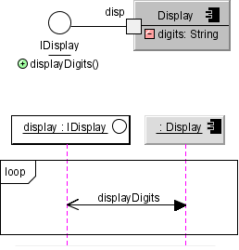
Modelling Component Protocols
Use subset of UML2.0
sequence diagrams
Translate to FSP [35]
Looking for [2]:
  Bad & No activity (deadlock)
Composite protocols
from leaf protocols
Picks up sharing problems well.
Translates easily, but is limited. Add to in future.
To do: Add support for indexed ports + modes

Slide 20
Goal Level Properties
Expect much of the future work to focus on this
Extensions often frustrate each others goals
How can we express the goal of features of the base and extensions, to detect conflicts
  resolve or guide resolution
Looking for an engineering approach
  Don’t want to use straight FSP
  Perhaps use sequence diagrams across components
  May lead to implied scenarios [60]

